Slide 1
Two steps forward, one step back:
A reluctant open data science transformation in lakes research and beyond Jeff Hollister

Slide 2
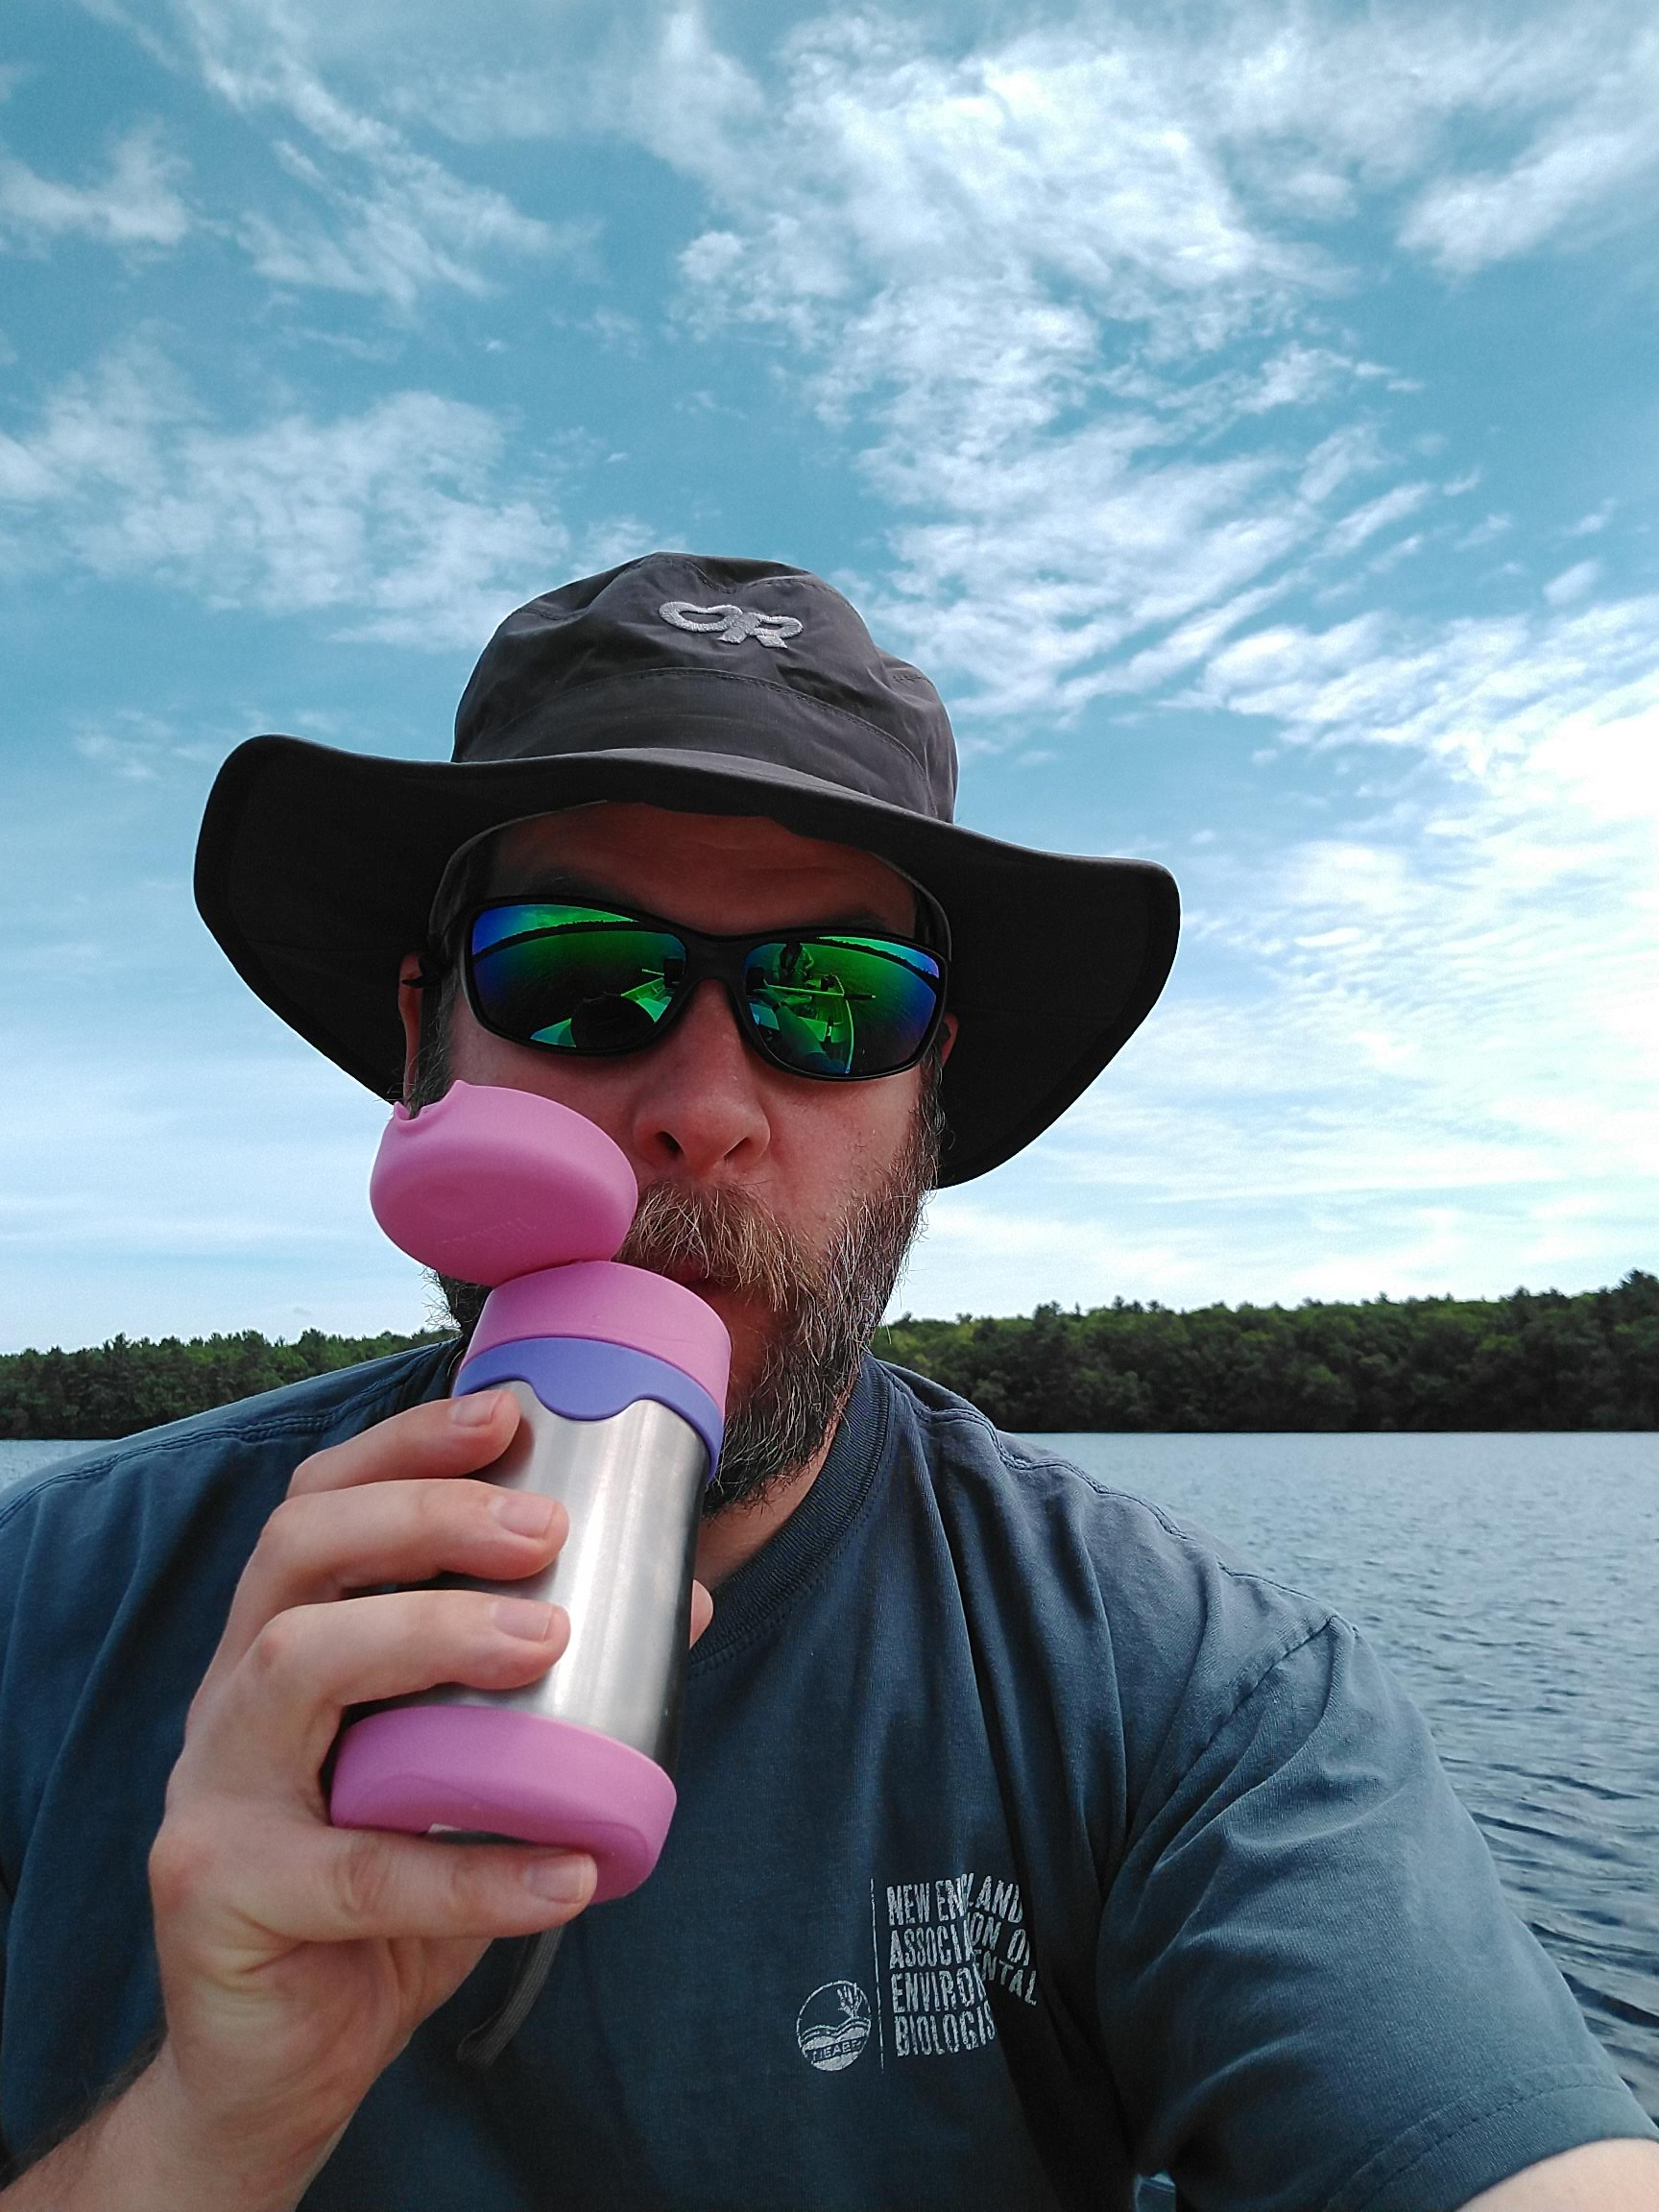
Who am I?
Landscape ecologist/GIS
Fake limnologist
Fake R guy
US EPA Research Ecologist since ~2006
Worked on: Forests, wetlands, gopher tortoise, estuaries, lakes, cyanobacteria, …

Slide 3
The rest of the cast
Lakes and Computational Ecology
Betty Kreakie
Bryan Milstead
Stephen Shivers
Sophie Fournier
Farnaz Nojavan (Alumnus: now a Data Scientist at FM Global)
Administrative/Legal/IM
Ann Vega
Valerie Brandon
Michelle Ibarra
David Smith
Scott Albright
Geoff Cooper
Ethan McMahon
Andrew Yuen

Slide 4
The story
Lakes and cyanobacteria
Computational approaches
Open data science tools

Slide 5
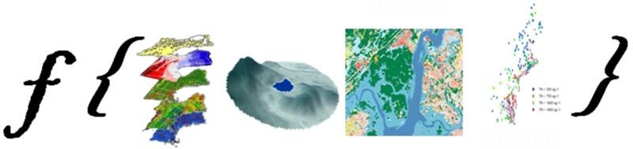

Slide 6

Two steps forward: R
In use for a long time
Growth in users
ORD, Regions, Client Offices
Installs originally ad hoc

Slide 7
One step back: R
Tightly controlled and changing IT environment
Install approvals onerous and inconsistent
Often only partly-functional
Much angst

Slide 9
Progress: R
Standardized installation
Pre-approved
Requests via email
Still occasional problems…

Slide 10


Slide 11
Two steps forward: GitHub
GitHub for USEPA ~2013
167 repositories
623 members in the USEPA Org
177 members who have committed

Slide 12


Slide 13
One step back: GitHub
No collaboration for you
Priced out?
No Admin rights

Slide 15
Progress: GitHub
Can now use a collaboration platform to collaborate!
Pricing issue still a work in progress
Discussions about using multiple Orgs
Enterprise GitHub
Bitbucket…

Slide 16
Two steps forward: Pre-prints and post-publication review
Hollister et al. (2016). Modelling lake trophic state: a random forest approach. Ecosphere
Uses NLA 2007
Random forests to predict chlorophyll a based trophic state
After clearance, before peer-review published as a PeerJ Preprint

Slide 17
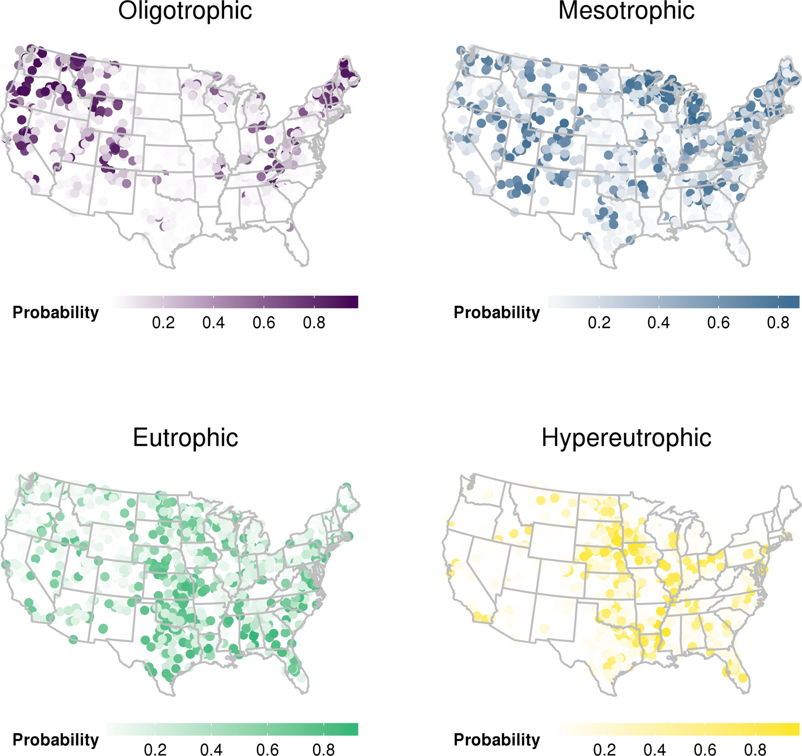

Slide 18
Two steps forward: Pre-prints and post-publication review
Hollister and Kreakie. (2016). Associations between Chlorophyll a and various Microcystin-LR Health Advisory Concentrations. F1000Research
Uses NLA 2007
Empirical method to answer, “What is a bloom?”
Published at F1000Research immediately after clearance

Slide 19
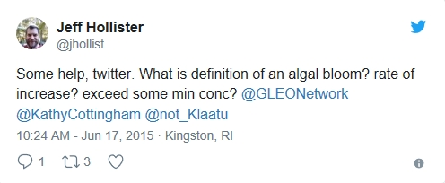

Slide 20
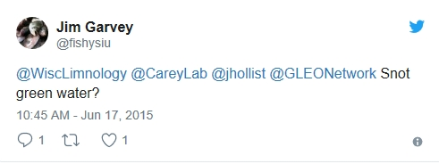

Slide 21
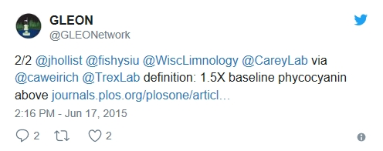

Slide 22
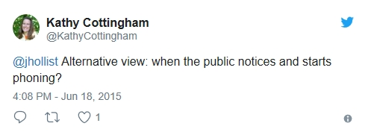

Slide 23
One step back: Pre-prints and post-publication review
Why would you do such a thing?
Many emails
And again, much angst

Slide 25
Progress: Pre-prints and post-publication review
Separate briefing lab senior managers on open science
Pre-prints and post-publication tacitly allowed
An interim policy

Slide 26
Two steps forward: Code review
lakemorpho: Lake morphometry metrics in R
sp, rgdal, rgeos, and raster
sf support to be added
National Lake Morphometry
NHD Plus
Hollister and Milstead (2010)
Hollister et. al. (2011)
Hollister and Stachelek (2017)

Slide 27
Two steps forward: Code review
elevatr:Access elevation data in R
Access elevation data in R
Mapzen
closed!
AWS
USGS
Built off of sp, rgdal, rgeos, and raster suite
sf support to be added
Development version has support for SRTM and sf objects

Slide 28
One step back: Code review
First attempt failed (see One step back: GitHub)
Lack of internal review mechanism for scientific software
But got reviewed anyway

Slide 30
Progress: Code review
New GitHub collaborator policy
Draft Scientific Software Clearance policy
With EPA Office of Research and Development Senior Managers

Slide 31
Two steps forward: Licensing
Creative Commons Zero (CC0) Approved in 2015
Federal Source Code Policy promised guidance

Slide 32


Slide 33
One step back: Licensing
Not quite there…
CC0 isn’t OSI approved
Guidance never came
Prevented use of Journal of Open Source Software

Slide 35
Progress: Licensing
As of early 2019, approval for MIT, GPL v3, LGPL-2.1, and Apache 2.0.
Other licenses are under review

Slide 36

Two steps forward: Shiny
Everyone wants Shiny!
Various internal servers and apps over the years
~20 applications on central server, many others elsewhere
EPA building skills and demand for Shiny applications
Have enterprise server
Examples on cloud.gov

Slide 37
One step back: Shiny
Made it through many “shining” doors, but never sure what is on the other side
Enterprise Shiny Server progress measured in years
Many technical hurdles with cloud.gov (i.e. don’t be first)

Slide 39
Progress: Shiny
Tantalizingly close to first apps on shiny.epa.gov
Making progress on other fronts for Shiny (e.g. EPA AWS Platform)

Slide 40
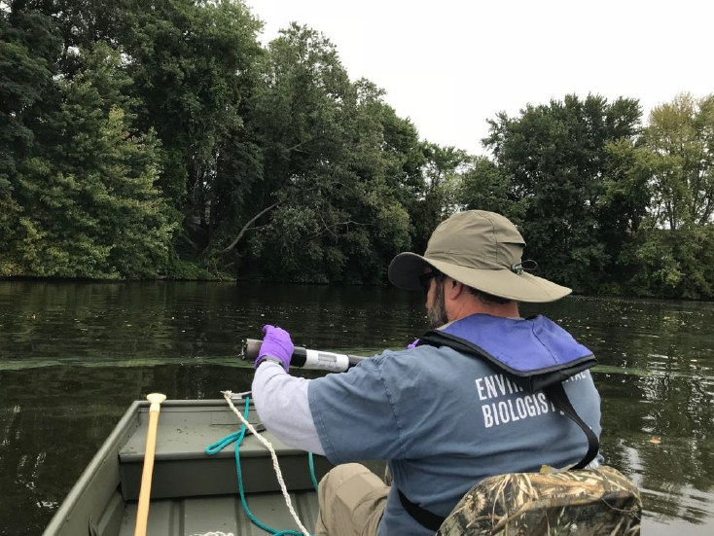
Two Steps Forward: Bringing it all together
Current project: Temporal and spatial dynamics of cyanobacteria in Rhode Island ponds
Twice weekly sampling
Three ponds in RI
7 stations per pond
Chlorophyll, phycocyanin, nutrients, physical profiles, zoo- and phytoplankton
Uses much of the open data science toolset

Slide 41
One Step Back: Bringing it all together
So far, so good!

Slide 43
Unorganized parting thoughts
Future challenges
FLAMe and DIY buoys
Data collection from buoys anticipated as an issue
This is a documentary, not a how-to
Much of this progress required a bit of subversion

Slide 44
